Slide 1
Advanced Systems Analysis and Design Physical Data Design SOFT 30121 L14

Slide 2
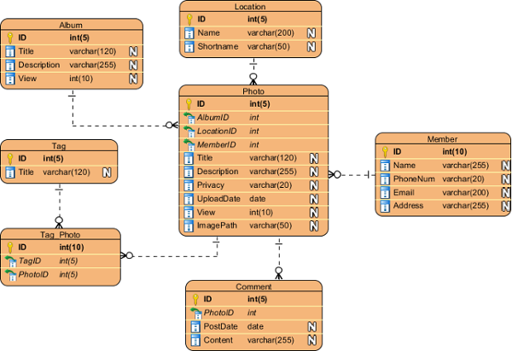
Physical Data Design
RecoSystems Analysis and Design
Alan Dennis; Barbara Haley Wixom; Roberta M. Roth
2019
Chapter 11

Slide 3
Physical Data Design
Objectives of Lecture 14
Identify and describe the purpose of the five type of files that are used to store business information.
Identify and describe the purpose of the different types of databases that are used to store business information.
Discuss the considerations to be made when selecting a data storage format.
Discuss the five steps involved in converting the logical data model to a physical data model.
Explain how to optimize the data storage design for storage efficiency.
Explain the several reasons to apply denormalization to the data storage design.
Explain the purpose of indexing when applied to the data storage design.

Slide 4
Introduction
As analysts turn their attention to the data storage that will be needed for the new system, several things must be done.
First, the data storage format for the new system must be selected. This chapter describes a variety of data storage formats and explains how to select the appropriate one for your application.
There are two basic types of data storage formats for application systems: files and databases. There are multiple types of each storage format; for example, databases can be object‐oriented, relational, multidimensional, and so on. Each type has certain characteristics that make it preferable for certain situations.
Following the selection of the data storage format, the data model created during analysis is modified to reflect this implementation decision. The logical data model will be converted into a physical data model.

Slide 5

Data Storage Formats
There are two main types of data storage formats: files and databases.

Slide 6
Data Storage Formats – Files
Files are electronic lists of data that have been optimized to perform a particular transaction.

Slide 7
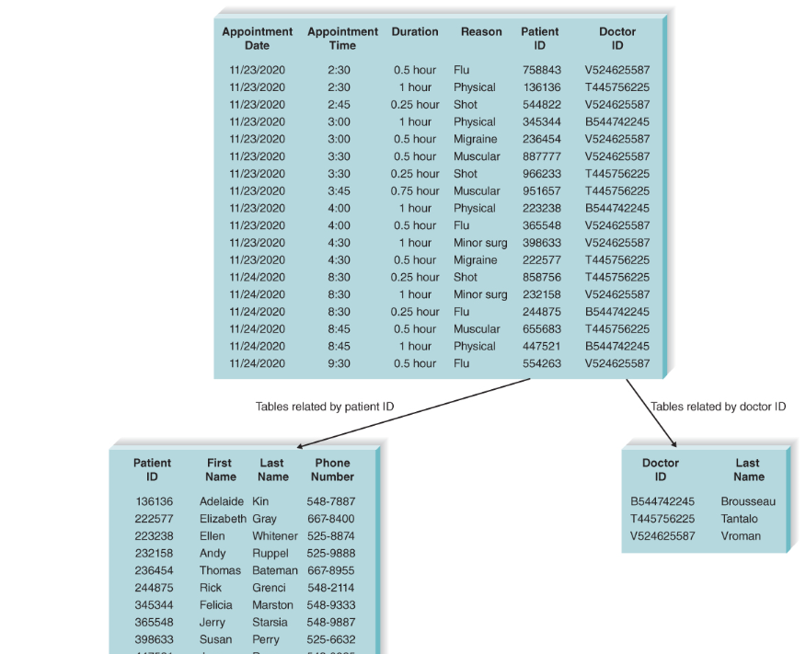
Data Storage Formats - Databases
A database is a collection of groupings of information that are related to each other in some way (e.g., through common fields). Logical groupings of information could include such categories as customer data, information about an order, and product information

Slide 8
Types of Files
Master files
store core information that is important to the business and, more specifically, to the application, such as order information or customer mailing information. They usually are kept for long periods, and new records are appended to the end of the file as new orders or new customers are captured by the system. If changes need to be made to existing records, programs must be written to update the old information.
Look‐up files
contain static values, such as a list of valid codes or the names of the US states. Typically, the list is used for validation. For example, if a customer's mailing address is entered into a master file, the state name is validated against a look‐up file that contains US states to make sure that the value was entered correctly.
A transaction file
holds information that can be used to update a master file. The transaction file can be destroyed after changes are made, or the file may be saved in case the transactions need to be accessed again in the future. Customer address changes, for one, would be stored in a transaction file until a program is run that updates the customer address master file with the new information.
An audit file
records “before” and “after” images of data as the data are altered, so that an audit can be performed if the integrity of the data is questioned.
The history file (or archive file)
stores past transactions (e.g., inactive customers, past orders) that are no longer needed by system users. Typically, the file is stored off‐line, yet it can be accessed on an as‐needed basis.

Slide 9
Nigel’s viewpoint on file types
Other axes of file types to be thinking about in terms of file storage
File Type | Pros | Cons
CSV or Tab Delimited | Easy to open in Excel. Easy to report in this format. | Hard for structured data.
XML otherwise known as tag delimited | Easier to handle structured data. Allows for strong data typing. | Verbose Fussy formatting
JSON or Javascript Object Notation | Easier to handle structured data. Non Verbose Cleaner formatting | Newer. Not as much handles JSON.

Slide 10
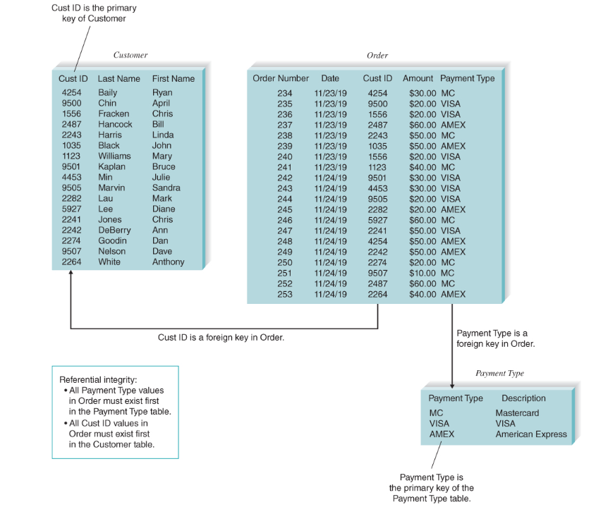
Relational Databases
A relational database is based on collections of tables, each of which has a primary key whose value is different for every row of the table. The tables are related to each other by the placement of the primary key from one table into the related table as a foreign key

Slide 11
Other Types of Databases
Object Databases
The basic premise of object orientation is that all things should be treated as objects that have both data (attributes) and processes (behaviors).
Multidimensional Databases
a type of relational database that is used to take data from a company's transaction processing systems, transforming the data (e.g., cleaning them up, aggregating them), and then storing the data for use in a data warehouse that supports business intelligence (BI) systems.
NoSQL Databases
This category of databases contains a wide variety of database approaches that evolved for different purposes.
Document‐oriented databases
manage collections of documents where those documents can have a variety of structures
Wide column stores,
also called extensible record stores, store data in records with an ability to hold very large numbers of dynamic columns
Graph databases
use graph theory to store, map, and query relationships. A graph database is essentially a collection of nodes and edges. Each node represents an entity (such as a person) and each edge represents a connection or relationship between two nodes.

Slide 12
Nigel’s viewpoint on Databases
I see the world in 3rd normal form. It strikes me as an accurate way to represent the world.
I find NoSQL movements a bit harder to cleanly represent the world, so a big part of this is how clean you want the world to look.
In database systems, ACID (Atomicity, Consistency, Isolation, Durability) refers to a standard set of properties that guarantee database transactions are processed reliably. ACID is especially concerned with how a database recovers from any failure that might occur while processing a transaction.
Non ACID databases allow for “eventual consistency”.
We built wide column databases (which we referred to as 4th Normal Form) by building tables of additional attributes. Purests were aghast thinking that metadata should be in one place.

Slide 13
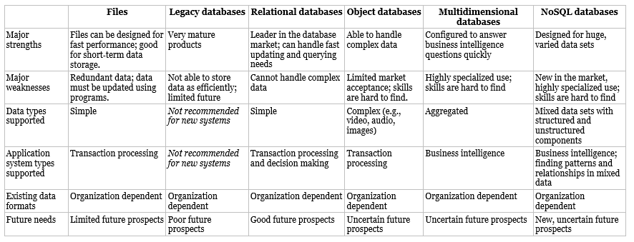
Choosing your data storage format

Slide 14
Moving from Logical to Physical Data Models
Step | Explanation
1. Change entities to tables or files. | Beginning with the logical ERD, change the entities to tables or files and update the metadata.
2. Change attributes to fields. | Convert the attributes to fields and update the metadata.
3. Add primary keys. | Assign primary keys to all entities.
4. Add foreign keys. | Add foreign keys to represent the relationships among entities.
5. Add system‐related components. | Add system‐related tables and fields.

Slide 15
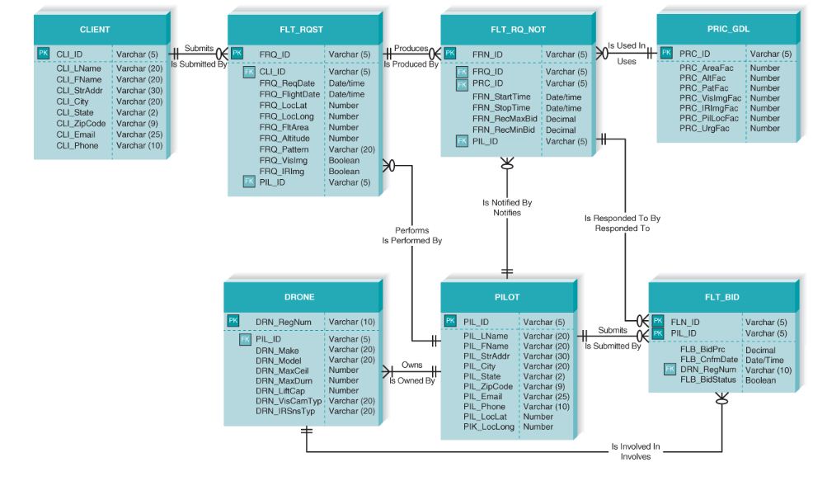
Physical Model – Database Oriented

Slide 16
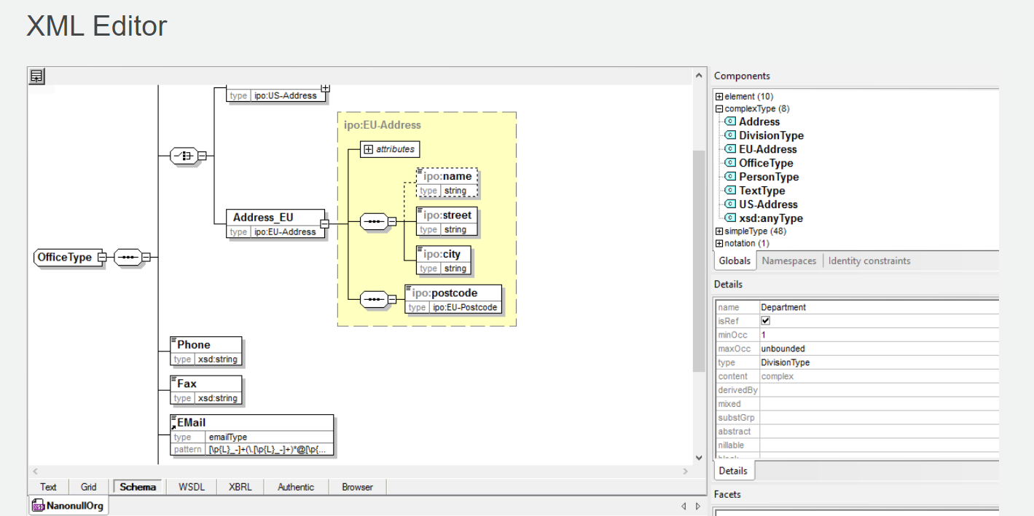
Physical Design – XML Oriented

Slide 17
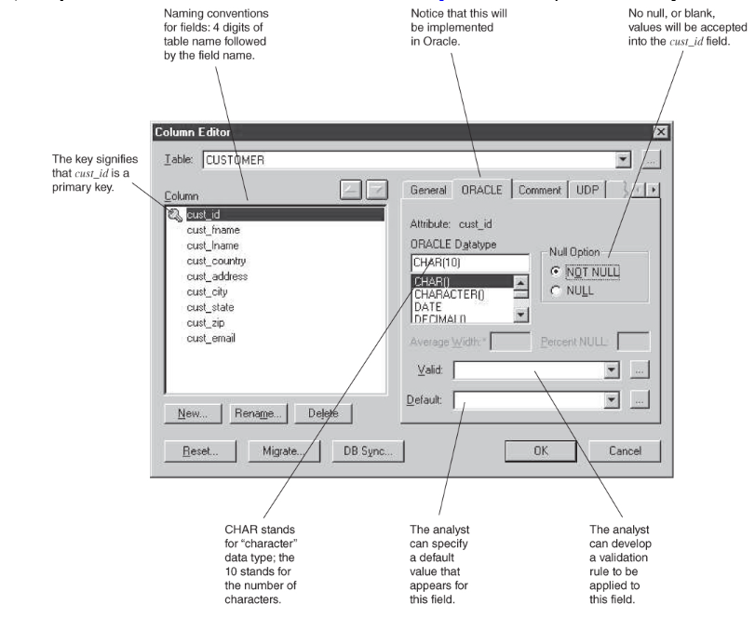
Database Data Dictionary

Slide 18
Nigel’s perspectives on non relational data storage
If you are moving into CSV, you must have a very simple flat structure.
If you are moving into XML schema, you have to have a “Top” and you cant have Many to Many.
If you are moving in JSON, it is really the same hierarchical design as XML Schema

Slide 19
Optimizing Storage Design
Efficiency of storage = normalized = slower reads + faster writes
Efficiency of access = denormalized = faster reads + slower writes.

Slide 20
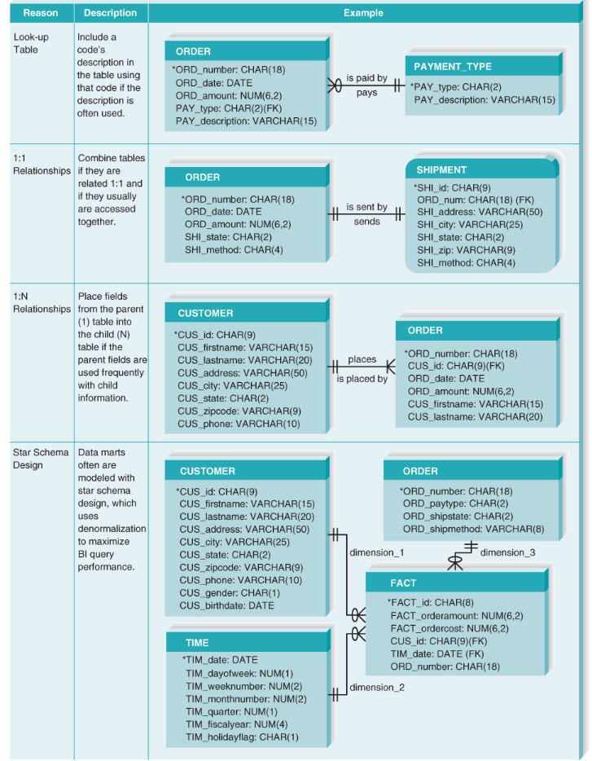
Optimizing Storage Design

Slide 21
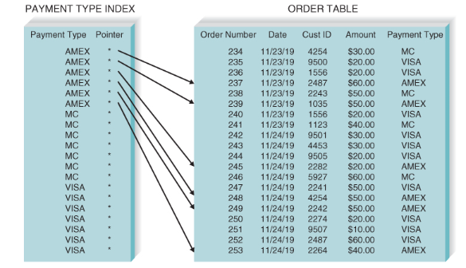
Indexing
Indexing is a way for a query to access the rows that are needed more quickly. It operates just like the index to a book.
When you insert rows you also update indexes so you have the same optimization issues. Speed of writes vs speed of reads.
You also have to consider whether you expect queries to be very selective (indexes are efficient) or most of the rows will be returned (table scans are efficient)

Slide 22
Chapter Review
Identify and describe the purpose of the five type of files that are used to store business information.
Identify and describe the purpose of different types of databases that are used to store business information.
Discuss the considerations to be made when selecting a data storage format.
Discuss the five steps involved in converting the logical data model to a physical data model.
Explain how to optimize the data storage design for storage efficiency.
Explain the several reasons to apply denormalization to the data storage design.
Explain the purpose of indexing when applied to the data storage design.

Slide 23
Next Lecture
Source Control

